Slide 1
MEDEPLOY
Changing the way you receive healthcare

Slide 2
Meet Medeploy (Med-Deploy)
Medeploy is a healthcare startup devoted to making receiving healthcare and recovery from illness easy and affordable for all. Started by a budding group of individuals devoted to a cause, Medeply plans to offer a wide variety of healthcare and wellness kits curated by some of the best healthcare professionals to target specific diseases, in order to ensure contactless recovery which is easy and sustainable as we significantly reduce packaging. We hope you join us in our drive for an affordable and sustainable healthcare industry.

Slide 3
Why should you invest?
Our target audience ranges from small children to the elderly. Since everyone is affected by such diseases, we have a large target audience. We feel that the Healthcare market is severely untapped.
Due to the rising demand of contactless delivery of medication skyrocketed due the pandemic, more and more markets are struggling to change their delivery methods. Medeploy delivers contactless while being environmentally sustainable as well.
To our investors we guarantee a 15% return with a 70/30 split.

Slide 4
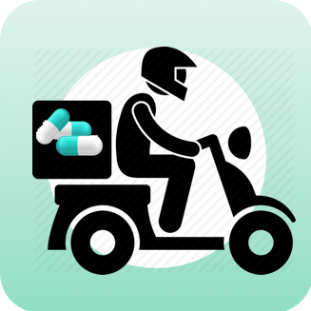
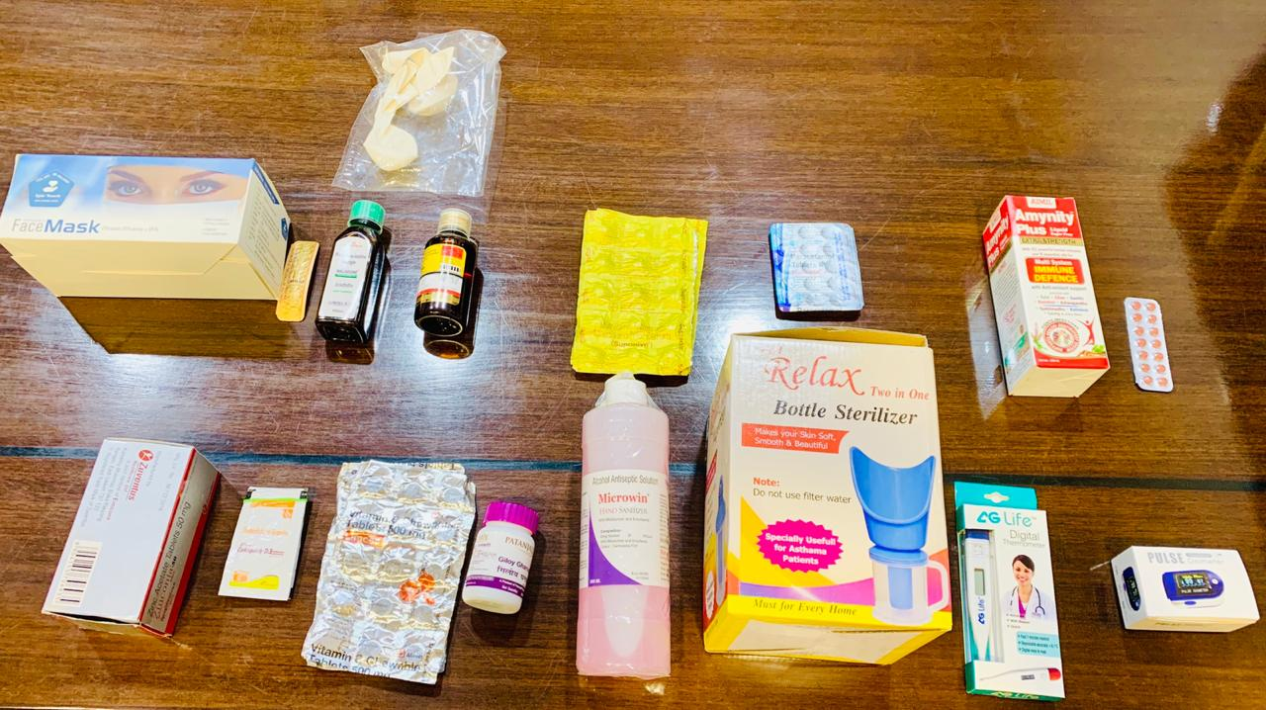
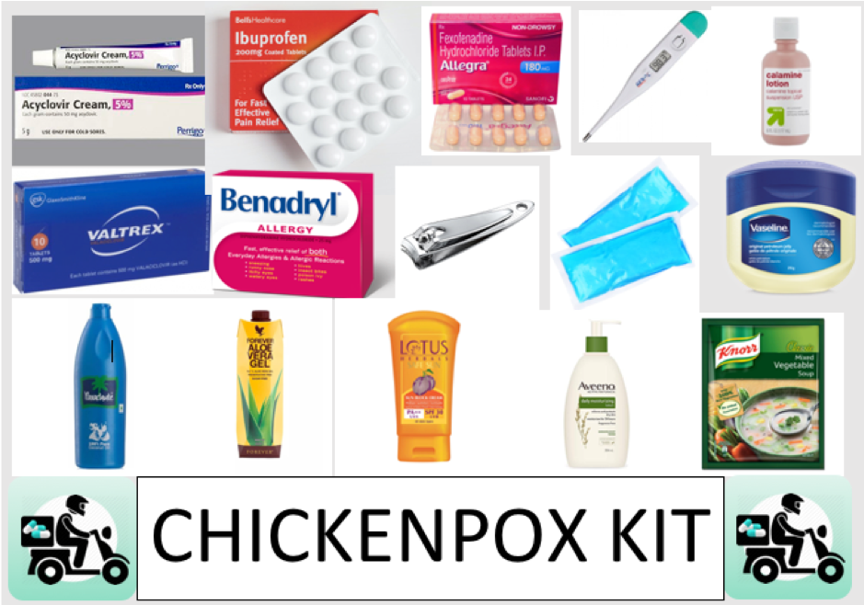
Our kits

